Slide 1
Effective Patterns
with C++11 and Boost

Slide 2
me
no books
no blogs
no tweets
no social accounts
no open source project

Slide 3

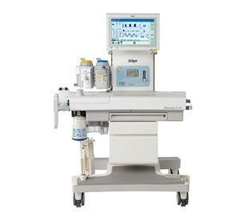
me
Dräger Lübeck
C++ developer
Trainings
Workshops

Slide 4
Motivation

Slide 5
Pattern
Common solution to a recurring problem
How many?
GoF-Patterns = Micropatterns

Slide 6
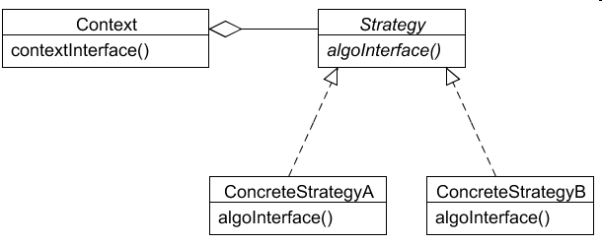
Strategy
Capsules a family of algorithms and makes them exchangeable

Slide 7

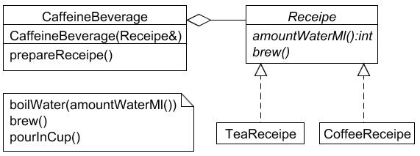
Strategy classic

Slide 8
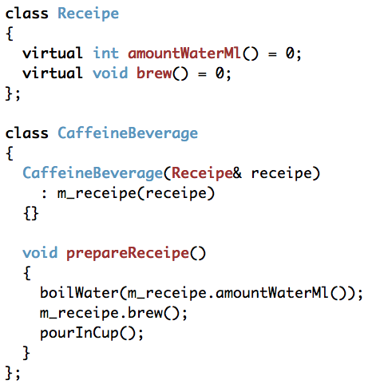
Strategy classic

Slide 9
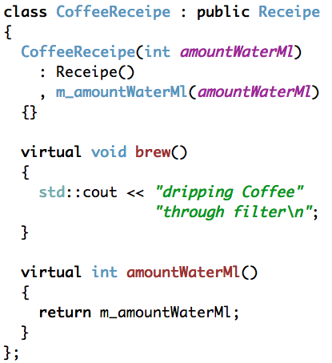
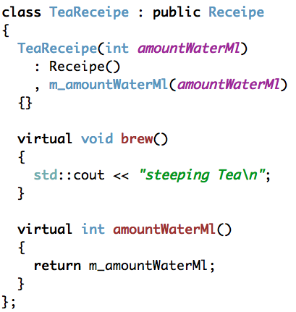
Strategy classic

Slide 10
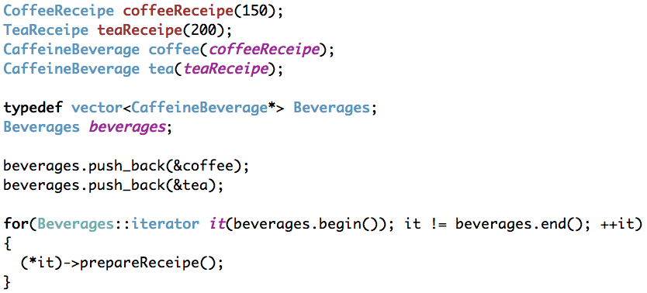
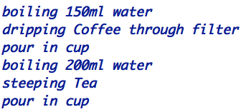
Strategy classic

Slide 11
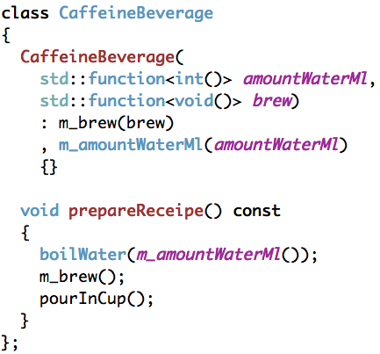
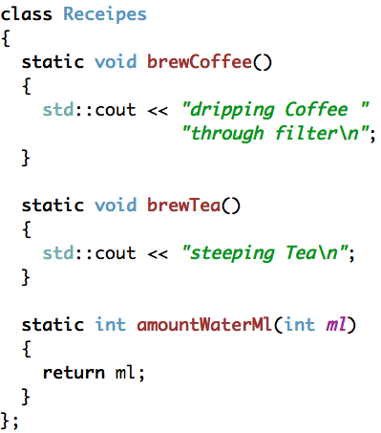
Strategy
C++11

Slide 12
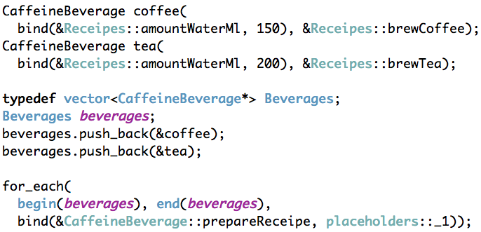
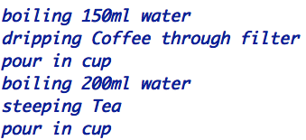
Strategy
C++11

Slide 13
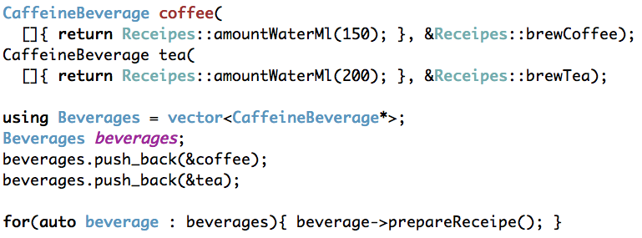
Strategy
C++11

Slide 14
Command
Encapsulate a request as an object

Slide 15
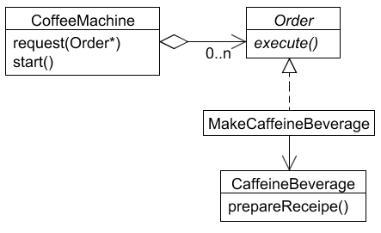
Command classic

Slide 16
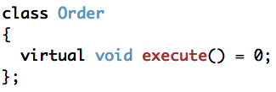
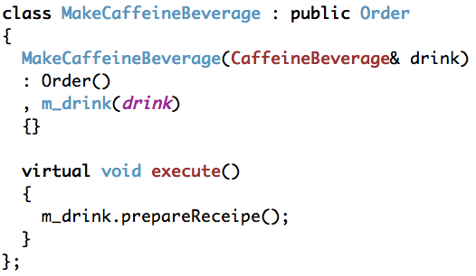
Command classic

Slide 17
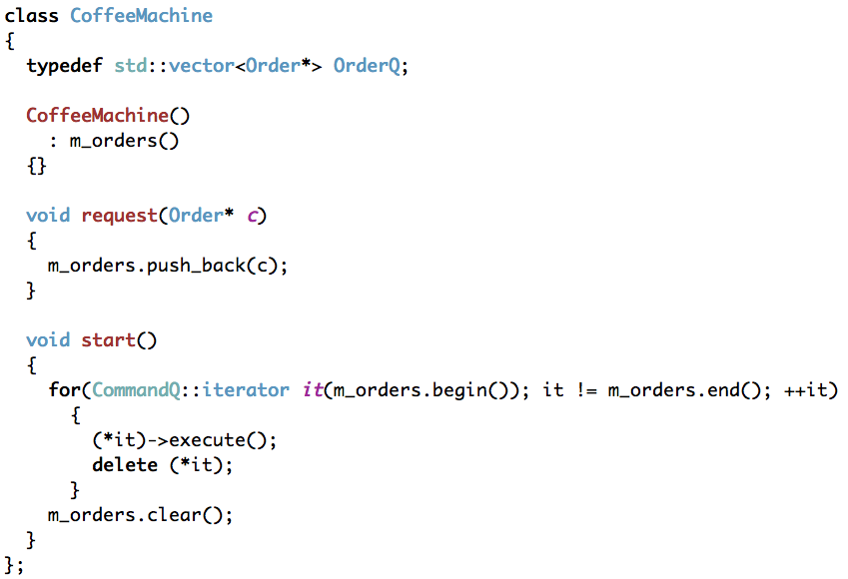
Command classic

Slide 18
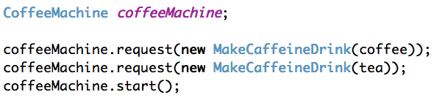

Command classic

Slide 19
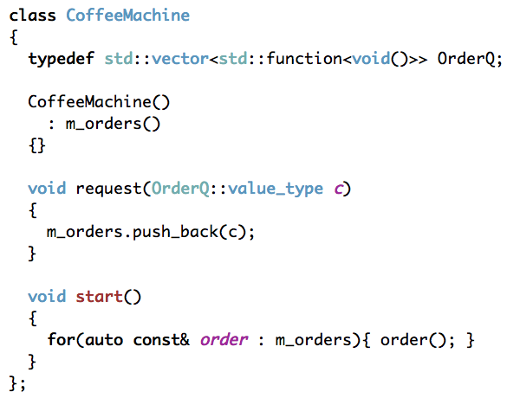
Command
C++11

Slide 20
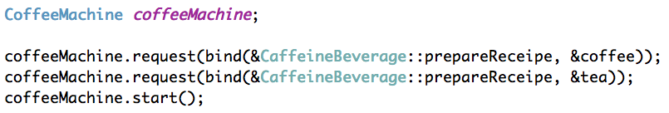
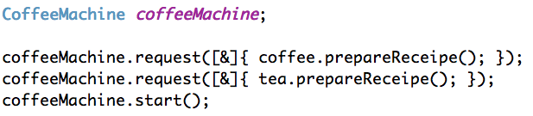
Command
C++11

Slide 21
Chain
Avoid coupling the sender of a request to its receiver by giving more than one object a chance to handle the request

Slide 22
Chain
TODO
Gof Chain diagram missing

Slide 23
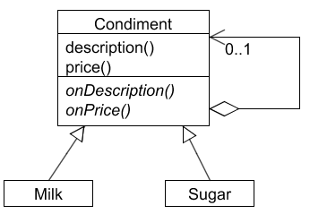
Chain classic

Slide 24
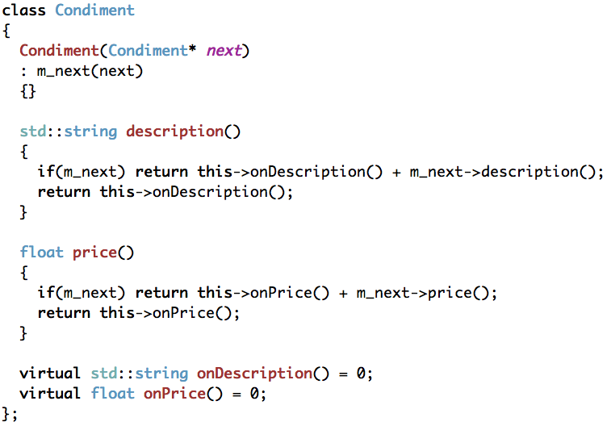
Chain classic

Slide 25
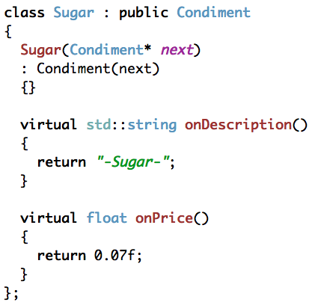
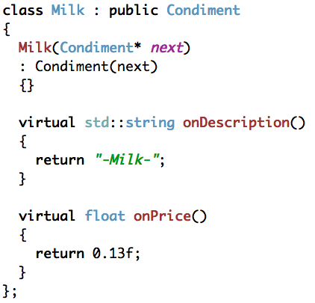
Chain classic

Slide 26
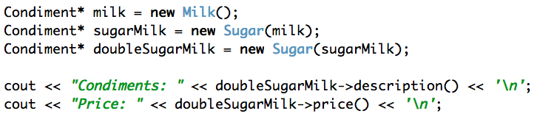

Chain classic

Slide 27
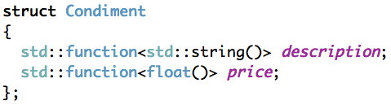
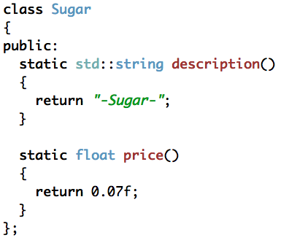
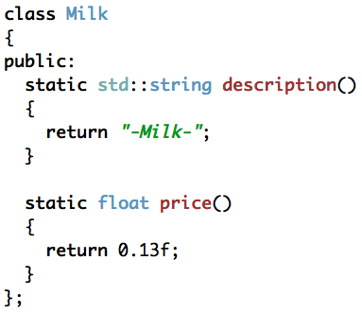
Chain
C++11

Slide 28
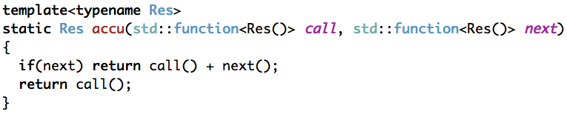
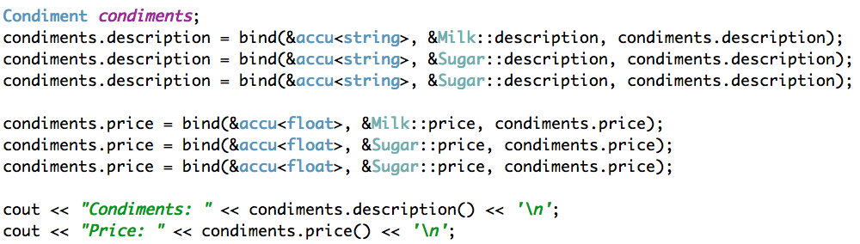

Chain
C++11

Slide 29
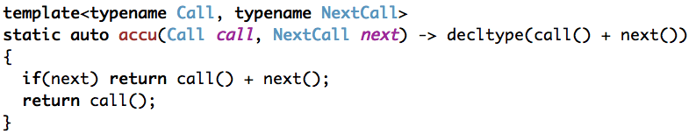
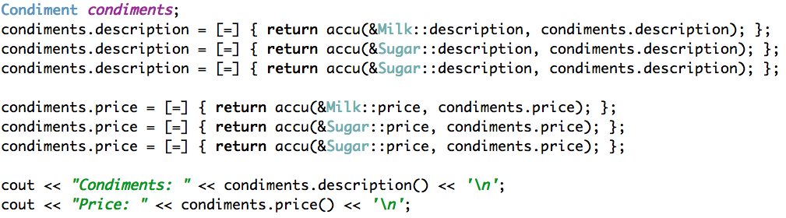
Chain
C++11

Slide 30
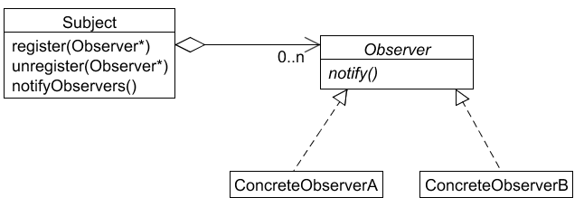
Observer
Define a one-to-many dependency between objects so that when one object changes state, all its dependents are notified and updated automatically.

Slide 31
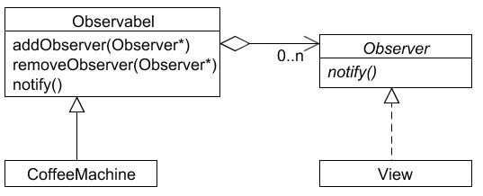
Observer classic

Slide 32
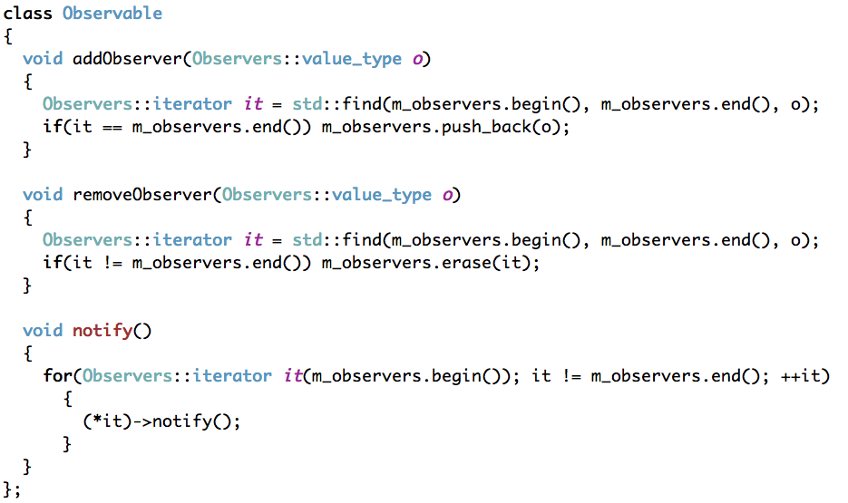
Observer classic

Slide 33
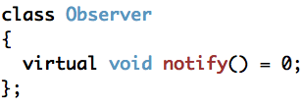
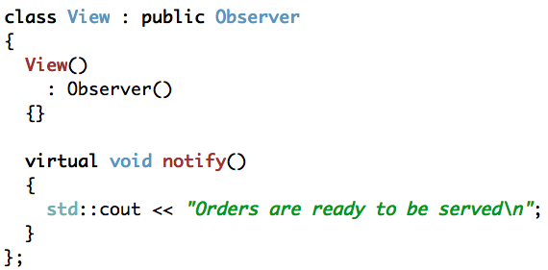
Observer classic

Slide 34
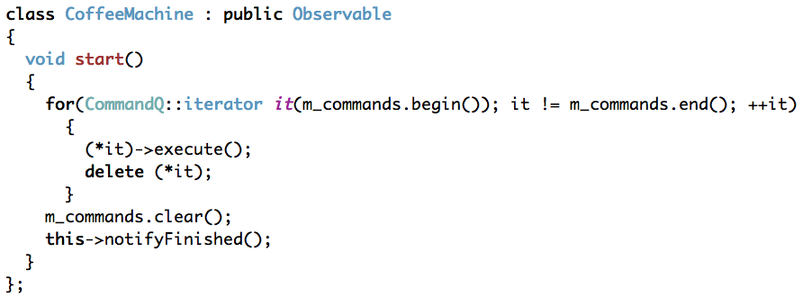
Observer classic

Slide 35
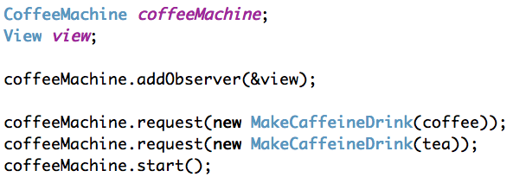
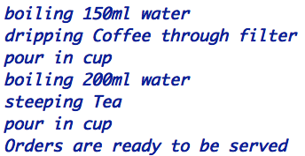
Observer classic

Slide 36
Observer
Boost.Signals2
Managed signals/slots system
Controling order of callbacks
Tracks connections and is capable of automatically disconnecting signal/slot connections when either is destroyed
Allows the user to specify the manner in which multiple return values are combined
Thread-Safe
Header-Only

Slide 37
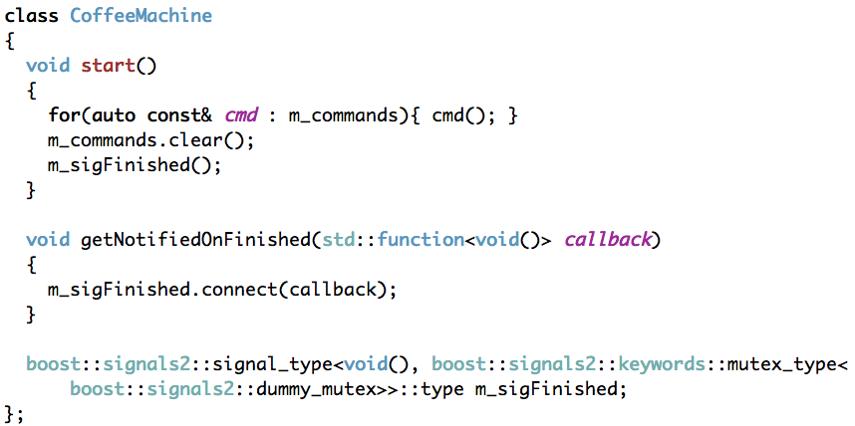
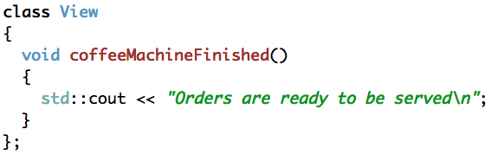
Observer
Boost.Signals2

Slide 38
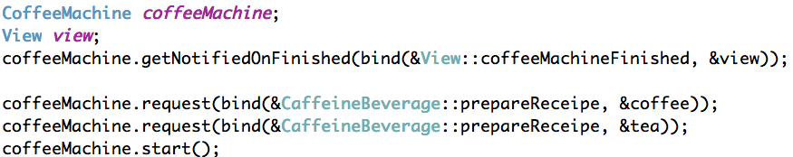
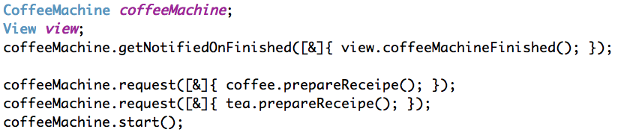
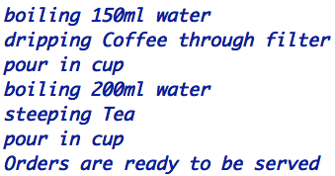
Observer
Boost.Signals2

Slide 39
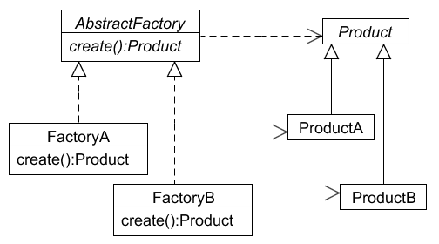
Factory
Provide an interface for creating families of related or dependent objects without specifying their concrete classes

Slide 40
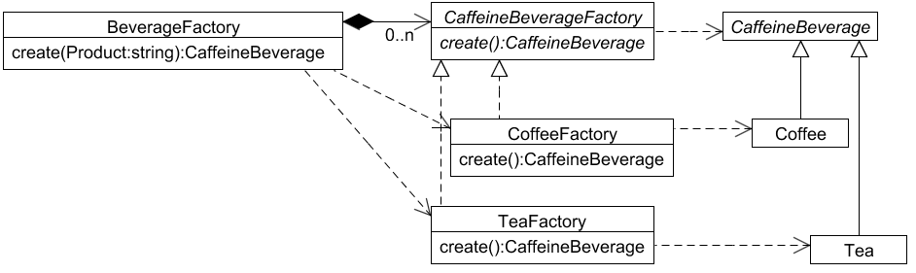
Factory classic

Slide 41
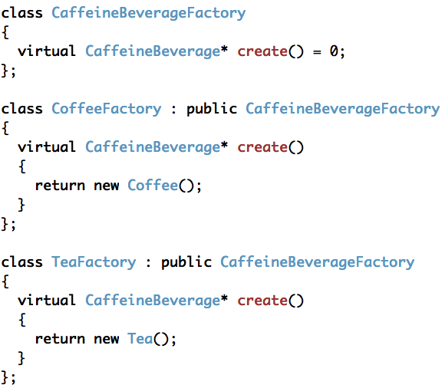
Factory classic

Slide 42
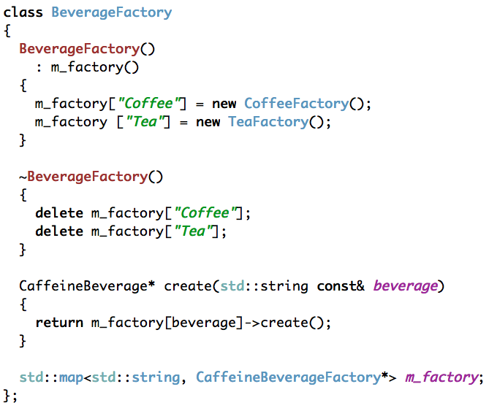
Factory classic

Slide 43


Factory classic

Slide 44
Factory
Boost.Functional.Factory
Lets you encapsulate a new expression as a function object

Slide 45

Factory
Boost.Functional.Factory

Slide 46

Factory
Boost.Functional.Factory

Slide 47

Factory
Boost.Functional.Factory

Slide 48
Where ist the patterns?

Slide 49
Benefits

Slide 50
Putting it all together

Slide 51
Conclusion

Slide 52
Pattern are crutches

Slide 53
Pattern for Communication

Slide 54
Natural Development

Slide 55
Pattern Lifecycle

Slide 56
Decorator
Attach additional responsibilities to an object dynamically

Slide 57
State
Allow an object to alter its behavior when its internal state changes

